Slide 1
Preliminary Design Review Presentation
NASA L’SPACE Mission Concept Academy Spring 2025
TEAM V.E.L.A.Z.Q.U.E.Z.
Venus Environmental Light and Atmospheric Zonal Quantification Under Extreme Zones
Prepared by: Eduardo Beltran, Emily Castro, Daxx Delucchi, Carter Garrett, Angel Guerrero, Grace Kirk, Briseyda Loescher, Luis Marquez, Shehan Rajapakse, James Rivera, Ethan Thai, Matthew Zhu

Slide 2
Agenda
Mission Overview
Summary of Mission Location
STM
Science Instrumentation Overview
Key Performance & Operational Specifications
Requirements and Constraints
Vehicle Design
Engineering Subsystems: Mechanical, C&DH, Thermal, and Power
Risk Mitigation
Overall Cost & Schedule
Conclusion & Next Steps
Notes:
Shehan

Slide 3
Mission Overview
Determine how Venus’s atmosphere and surface interact with one another.
Science Objectives & Importance
Volcanic Outgassing & Thermal Activity
What: Measure sulfur dioxide (SO₂) emissions and map thermal hotspots in Venus’s topography.
Why: Reveals how specific atmospheric constituents (SO₂) influence surface chemistry and erosion, and how subsurface heat flow drives atmospheric dynamics.
Impact: Quantifies the feedback loop between volcanic activity and atmospheric composition, guiding models of greenhouse processes on terrestrial planets.
Dust & Sand Motion Fluxes
What: Characterize near-surface wind speeds and granule (dust/sand) number densities.
Why: Determines how particulate transport affects atmospheric humidity, temperature profiles, and the nucleation and persistence of sulfuric-acid clouds.
Impact: Improves understanding of sediment-atmosphere coupling, with implications for climate stability and cloud-chemistry cycles on Venus.
Our Team had a $200 M cost cap and must be completed within 5 years.

Slide 4
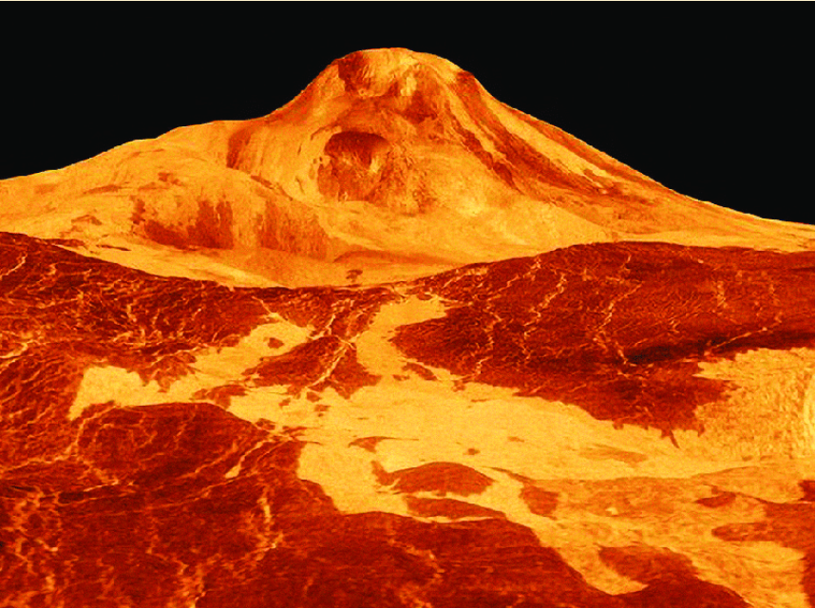
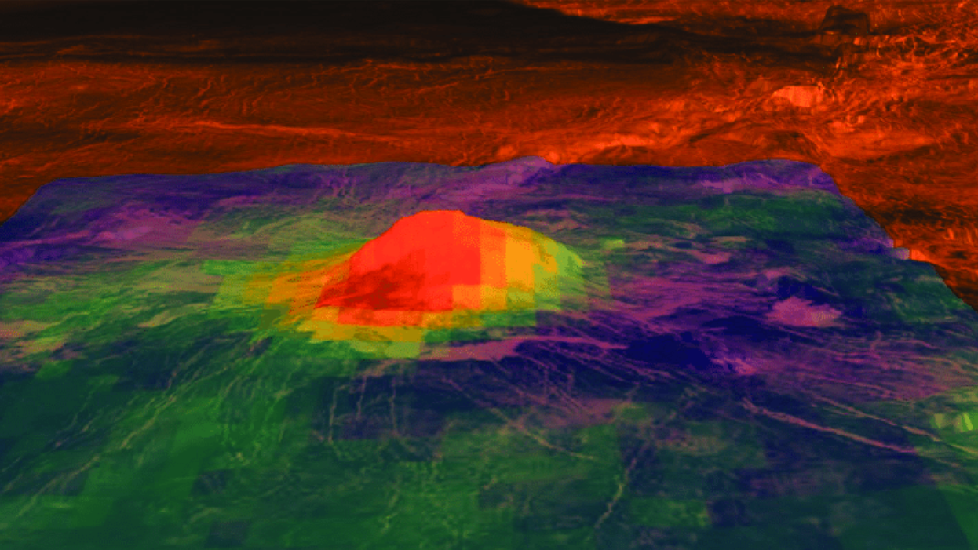
Mission Location Summary
Figure 1: 3D-rendered perspective view of Idunn Mons, a volcanic peak on Venus, based on radar data from NASA's Magellan spacecraft.
Figure 2: Infrared composite view of Idunn Mons, Venus, displaying thermal emissions indicative of recent volcanic activity.
Selected Site Overview
Highest overall suitability: Idunn Mons (96.5%)
Optimal combination of defined topography, stable atmosphere, and minimal instrument interference
Trade Study Criteria: Topography (35%), Atmosphere (35%), Interference (30%)
Criteria | Weight | Idunn Mons | Artemis Corona | Alpha Regio
Defined Topography | 35% | 10 | 9 | 10
Stable Atmosphere | 35% | 9 | 5 | 6
Instrument Interference | 30% | 10 | 4 | 3
Total Score |  | 96.5% | 61.0% | 65.0%

Slide 5
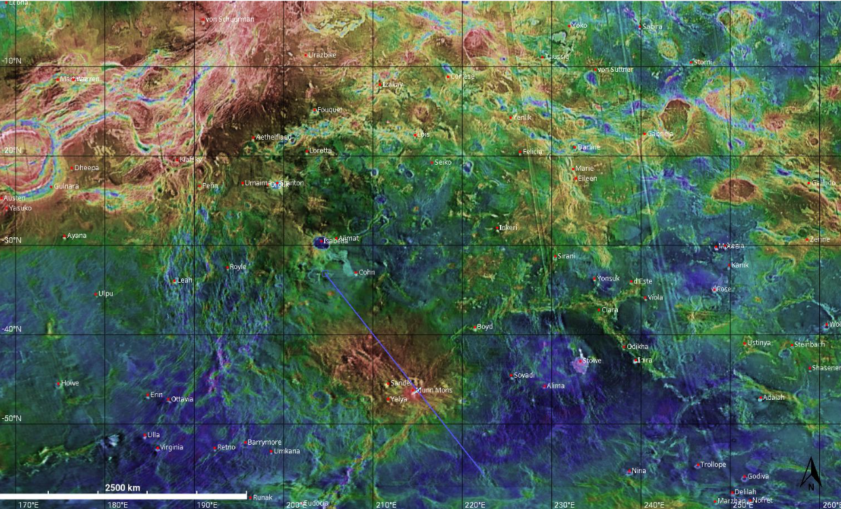
Map of Mission Location

Slide 6
Science Traceability Matrix
Science Goals | Science Objectives | Science Measurement Requirements |  | Instrument Performance Requirements |  | Predicted Instrument Performance | Instrument | Mission Requirements
 |  | Physical Parameters | Observables
From the Decadal Survey: Origins, Worlds, and Life, Question 6: Solid Body Atmospheres, Exospheres, Magnetospheres, and Climate Evolution. 6.4a: How do planetary surfaces and interiors influence and interact with their host atmospheres? Citation: (National Academies of Sciences, Engineering, and Medicine. 2023. Origins, Worlds, and Life: A Decadal Strategy for Planetary Science and Astrobiology 2023-2032. Washington, DC: The National Academies Press. https://doi.org/10.17226/2652) | Determine the amount of outgassing that occurs from volcanic injections of sulfur dioxide. (6.4a) | Quantify the amount of SO2 in the near-surface venusian atmosphere in the local region of the aerobot. | Collect the absorption spectrum in the 170 - 320 nm wavelength range for regions within 25 km of the aerobot. | Wavelength range: | 170 - 320 nm | 118 - 320 nm | UV/Vis Spectrometer for SO₂ Measurement (GSFC Advanced UV/Vis Spectrometer – collaboration with Horiba Scientific) | Aerobot shall maintain instrument aperture in downwards direction required for key science targets
 |  |  |  | Integration time | ~ 1 s | 11.2 ms
 |  |  |  | Sensitivity: | SNR > 20 | R = 2000
 |  |  |  | Spatial resolution: | 0.5 nm | 0.2 - 0.3 nm |  | Mission must collect images for at least 13 hours.
 | Determine the amount of modern volcanic outgassing from the venusian interior via thermal emission (6.4a) | Identify surface regions with high thermal emissivity. | Intensity of infrared radiation from the venusian surface in the 0.1 - 2 millimeter wavelength range for regions within 45 km of the aerobot. | Wavelength range: | 0.1 - 2 microns / mm | 0.1 micron - 2 mm | Infrared Radiometer/Spectrometer for Thermal Emissivity (Ball Aerospace Infrared Thermal Emission Spectrometer – Adapted design)
 |  |  |  | Integration time: | 1 s | ~ 1 s
 |  |  |  | Sensitivity: | 1 K | R = 100 |  | Aerobot will be inserted 70 km distance from target location
 |  |  |  | Spatial resolution: | .01 micron / 2 cm | ~ 1 cm
 | Determine the rate of dust lifting / sand motion in the near- surface atmosphere via dust and sand fluxes. (6.4c) Determine if water was ever present? This has atmospheric implications. | Quantify the wind speed and granule (dust, sand) number densities in the near-surface atmosphere. | Determine the amount of obscuration/scattering due to dust particles in the optical wavelength range (170 - 900 nm). | Wavelength range: | N/A (optical, 170 - 900 nm) | 255 - 750 nm | MEDA Dust and Radiance Tool (Adapted Design)
 |  |  |  | Spatial resolution: | 0.1 nm | 12 Mb image |  | Aerobot must cover at least 4,795 km of infrared imaging coverage.
 |  |  |  | Integration time: | 1 s | 57 kb/s
 |  |  |  | Sensitivity: | < 2 W/m^2 | .5 W/m^2

Slide 7
Science Instrumentation Overview
UV/Visible Spectrometer
Purpose: Quantify volcanic outgassing via SO₂ absorption in the 170–320 nm band
Heritage: GSFC Advanced UV/Vis Spectrometer (collaboration with Horiba Scientific)
Mounting: Downward-pointing aperture integrated into aerobot chassis
MEDA Dust & Radiance Tool
Purpose: Characterize near-surface aerosol optical depth and dust flux (170–900 nm)
Adaptation: Based on Mars Environmental Dynamics Analyzer (MEDA) suite
Mounting: Side-mounted for unobstructed field of view
Infrared Radiometer / Spectrometer
Purpose: Map surface thermal emissivity (0.1 µm–2 mm) to identify active volcanism
Heritage: Ball Aerospace Infrared Thermal Emission Spectrometer (adapted design)
Mounting: Horizon-pointing orientation for limb and surface scans

Slide 8
Requirements and Constraints
Aerobot Requirements
The aerobot shall autonomously collect, process, and transmit science data from the atmosphere and transmit it to the missions orbiter
The aerobot shall withstand withstand shocks, vibrational loads, involved throughout its life cycle
The system shall last at minimum 36 hours
The subsystem shall stay within 200 K to 350 K ±25 K
The system shall have an operational Command & Data Handling (CDH) subsystem that processes all data for transmission with a latency of 1 second (Obkio 2025)
The Aerobot shall be designed to operate within a 600 power budget to ensure sufficient energy for the operation of the mission
Aerobot Constraints
The aerobot shall fit within a 1m³ cube before launch
The mission shall utilize a maximum budget of $200 million
The aerobot shall be fully integrable with the descent subsystem
ALL REQUIREMENTS MET BY SYSTEM
✅

Slide 9
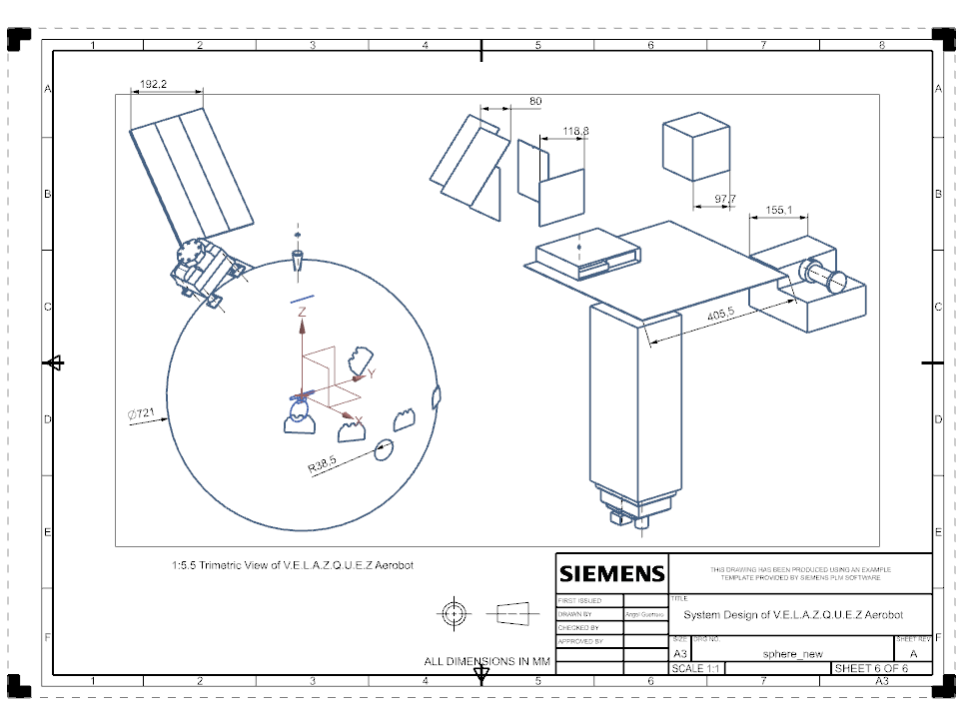
Vehicle Design
Involving new and previously used technologies
Placement of instruments was accounted for accommodation for everyone
Push near 45 kilogram constraint given by customer
Contain 5 subsystems to make the mission possible

Slide 10
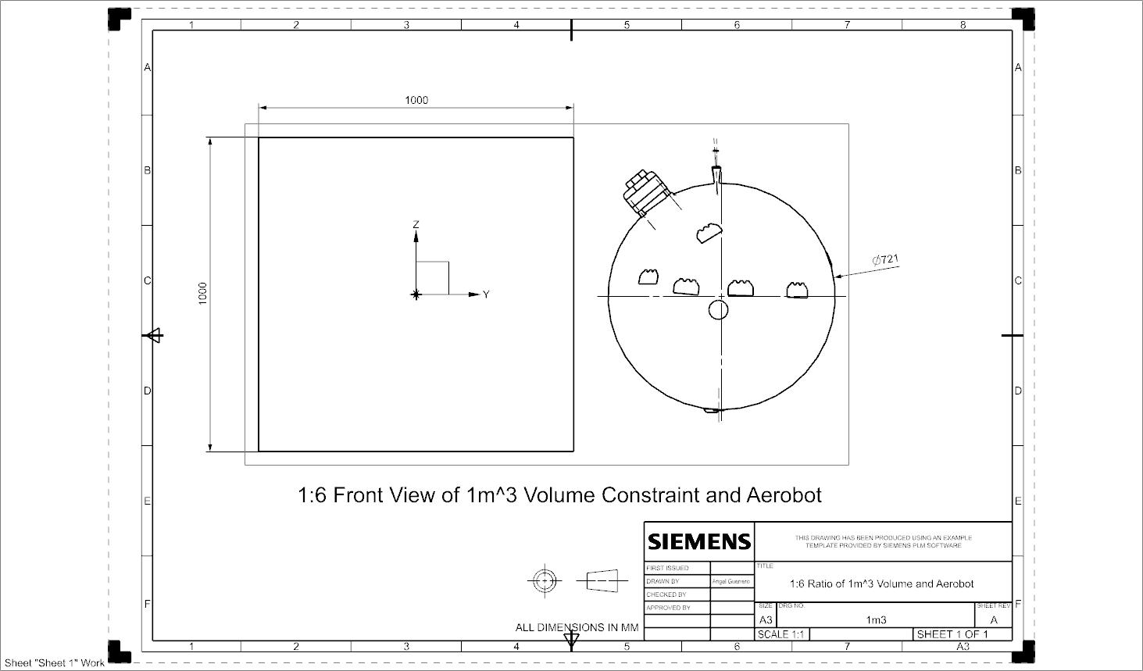
Differences in Constraint and SWaP
WBS | System / Subsystem | Description | Selected component | Mass (kg) | Total Dimensions m^3 | Power (W) | Dimensions in Interior m3 | Dimensions of entire aerobot m3
1.0 | Spacecraft | Entire spacecraft with all systems | Name of the component | 43.8060 | 0.6403220685 | 67.23975 | 0.03326449253 | 0.607155106
1.1 | Payload | Measures data for Science subteam | Scientific Data | 14.5000 | 0.0282081143 | -44
1.2 | Mechanical Structure | Contains structure and integration for subsystems | Chassis, Assembly, Cables, Sapphire window, Anti-corrosion coating | 18.9066 | 0.599394106 | 0
1.3 | Power | Powering subsystem for all systems requiring power | Battery, solar panels, and power distribution | 7.5000 | 0.012536376 | 632.11
1.4 | Thermal | System maintaining aerobot at operational temperatures | Heating strips, thermal sensor, Multi-layer insulation, and Black Paint | 0.2659 | 0.00018347223 | -340.00025
1.5 | Comms | Portion of CDH that will communication to DSS | ISARA, Spacewire, and QHA | 0.8135 | 0 | -10.3
1.6 | CDH | Processing unit for CD&H unit for the spacecraft | OBC, FCS, Storage, and Transceiver | 1.8200 | 0 | -51
1.7 | DSS | Descent Subsystem | N/A (MCA is in chage of Aerobot not DSS but need to supply power to DSS) | 0 | 0 | -10

Slide 11
Key Performance & Operational Specifications
Spectral & Sensitivity
UV/Vis: R = 2000, SNR > 20; integration time ~1 s
IR: R ≈ 100, ΔT ≈ 1 K; integration time ~1 s
Dust Tool: Δλ = 0.1 nm; sensitivity < 2 W/m²; 57 kb/s data rate
Spatial & Temporal Resolution
UV/Vis: 0.2–0.3 nm spectral resolution, 13 h continuous operation
IR: ~1 cm surface footprint at 45 km standoff
Dust Tool: 0.1 nm photometric bins, 1 s cadence
Operational Constraints
Orientation: UV/Vis downward, IR horizon, MEDA radial
Mission Duty Cycle: ≥ 13 h collecting UV/Vis; ≥ 4,795 km IR imaging coverage
Data Budget: Telemetry via DSN relay every 90 min; onboard storage via RH3440 recorder
Heritage & Collaborations
Instruments developed in partnership with GSFC, Ball Aerospace, JPL, and JHU/APL
Adaptation of proven designs to Venus’ extreme temperature and chemical environment ​
Notes:
Requirements derived from the spectral features of SO2, the trace volcanic target. Blackbody emission peaks give us target ranges for radiometry. Important for CDH Storage capacity requirement that integration times for exposures can fall anywhere between 4 ms and 4k ms.
10% baseline accuracy for the photometry required for accurate scattering detection.
Calibration will be thoroughly tested before launch. These processes will occur continuously in situ before exposures, with the dark and flat. We are meeting precision requirements and boosting readability and reliability of data with post collection destriping.
Attribute Goddard SFC, Ball Aero, Jet, and John Ho for heritage design and instrument collaboration elaboration

Slide 12
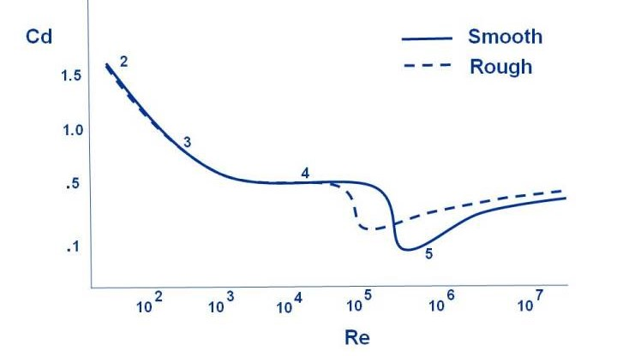
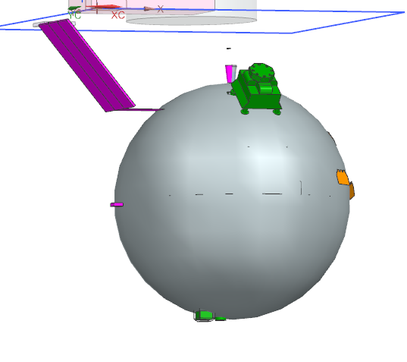
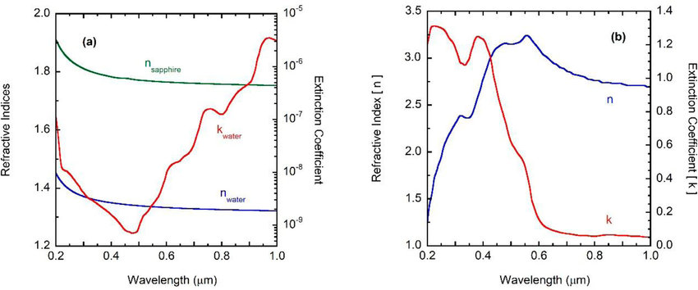
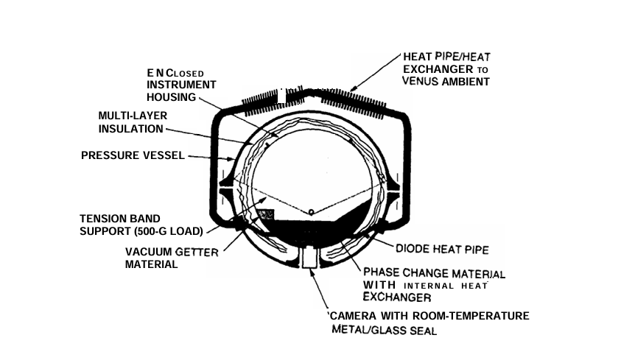
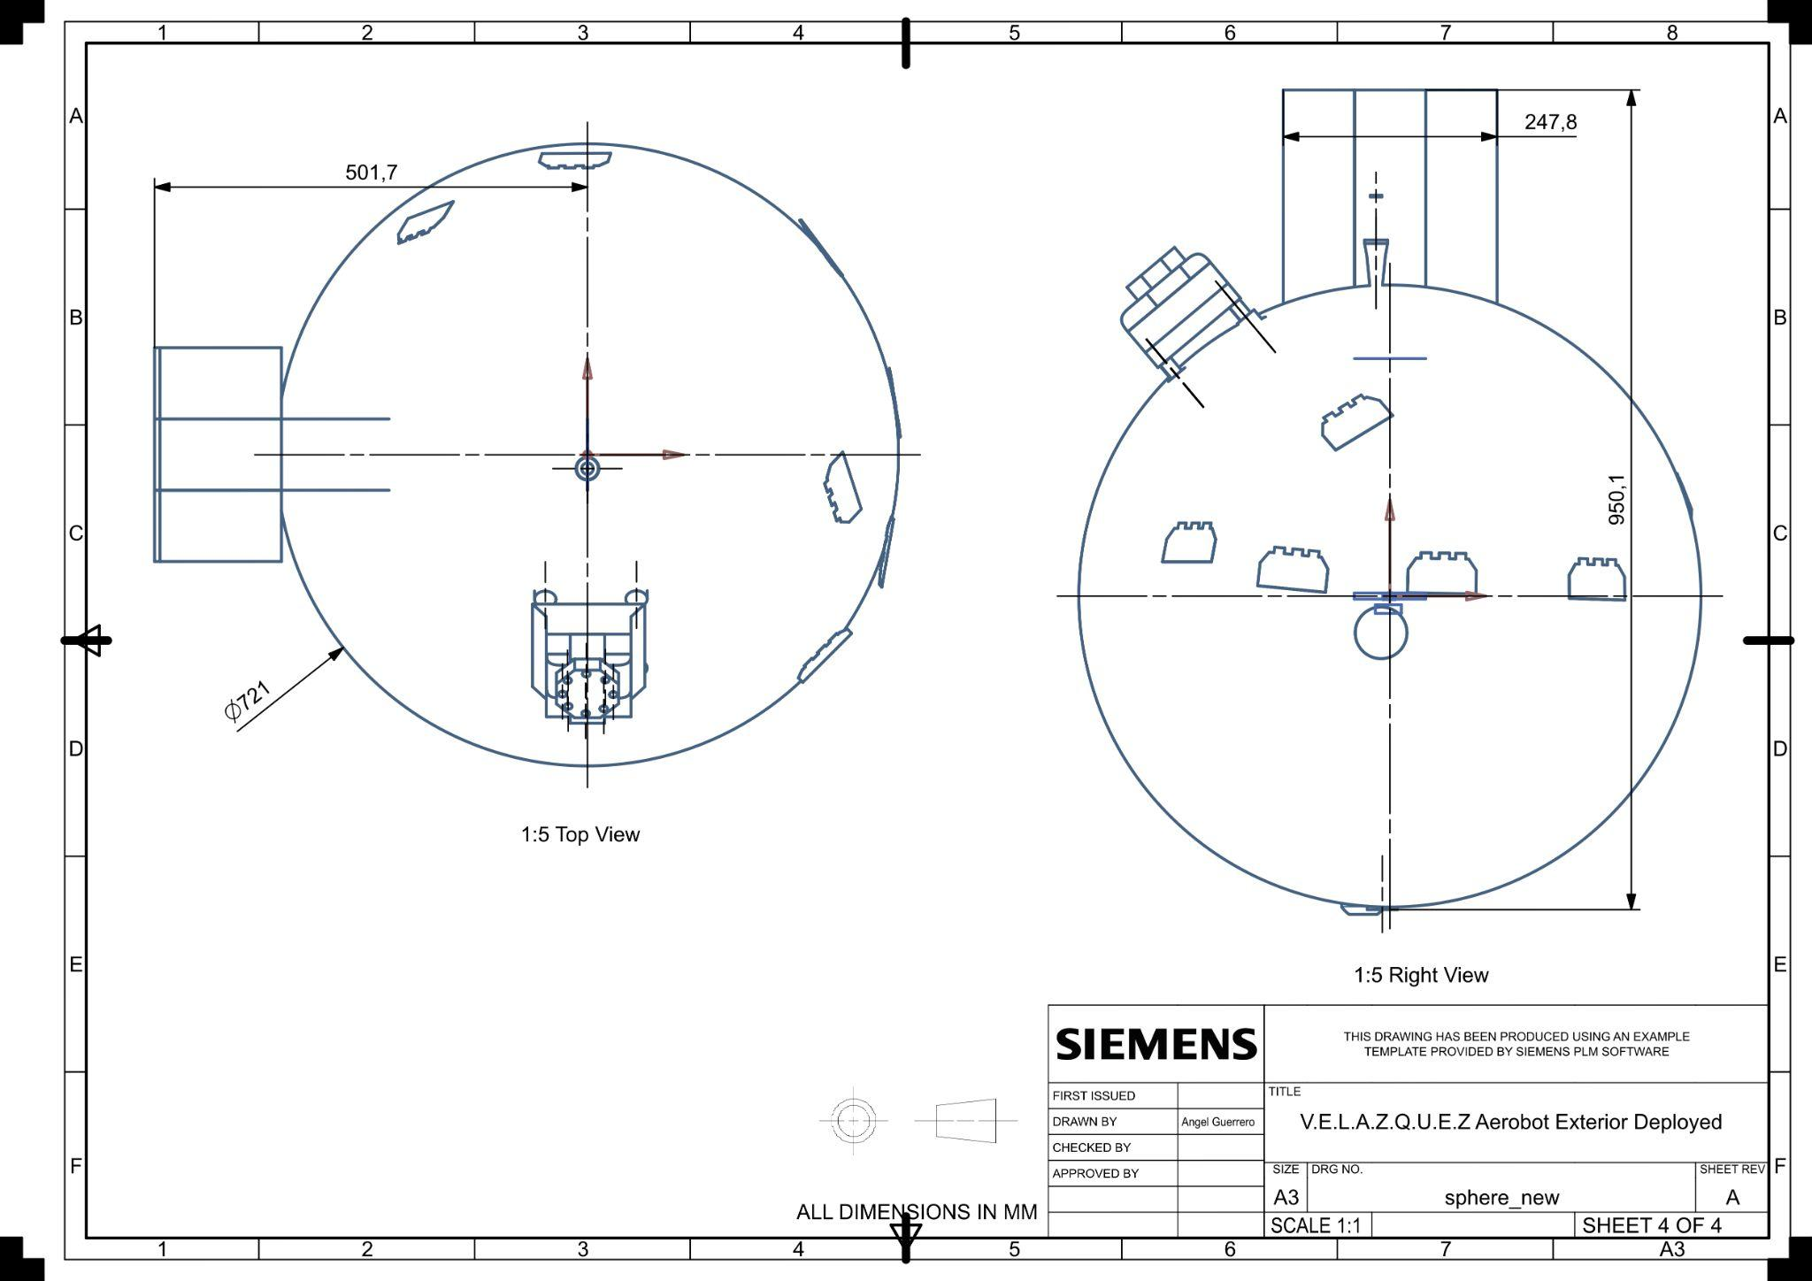
Mechanical Chassis Design
Aerobot Exterior
Vargas, William E, Junxin Wang, and Gunnar A Niklasson. 2021. “Effective Backscattering and Absorption Coefficients of Light Diffusing Materials Retrieved from Reflectance and Transmittance Spectra of Diffuse Radiation.” Journal of Modern Optics 68 (12): 605–23. 4.
‌
Hall, Nancy. 2023. “Drag of a Sphere.” Glenn Research Center | NASA. NASA. September 11, 2023. https://www1.grc.nasa.gov/beginners-guide-to-aeronautics/drag-of-a-sphere/.
Heun, Matthew Kuperus; Jones, Jack A., 1997, "Gondola Design for Venus Deep-Atmosphere Aerobot Operations", https://hdl.handle.net/2014/22106, Reno, Nevada, JPL Open Repository; 97-0557.pdf [fileName]
Notes:
Wanted to stabilize against extreme oscillations.
JPL has actually done extensive research on aerobot prototypes and published a lot in their open repository, and the spherical design choice won the trade study. The choice of sphere is simple enough and easily manufacturable in hemispheres with an aperture opening in the negative nadir direction. It also is thermally efficient, structurally sound.
Spherical viscosity actually has a second minimum, where for a sphere, the Reynolds number of the surface (if grainy) actually dampens turbulence more than other geometries for given medium viscosities.
Wanted to be able to have a constant solar flux. Regardless of solar position, irradiance on surface panels will be incident (mostly)
Biggest challenge was material selection and optimizing for mass and interior volume as well as structural support.
Mg A731b. NASA is developing next generation alloys to be used in aerospace applications, we found strains that suit our needs. The alloy is ⅔ the density of Al 6061 which was critical for meeting the mass requirement,m but it is not as chemically resistant.
Other alloys involved are beyond satisfactory for their applications, mechanical properties meet requirements for target environment though not all miniscule fastening components have been space tested
Sapphire window visible on

Slide 13







Mechanical Manufacturers and Procurement
Component | Primary | Secondary | Mass (kg) | Volume (mm³)
Chassis | AT Machining | A.R. Inc. | 15 | 106247796.98
Cables | McMaster - Carr | USCC | 1.92 | 492773779
Anodization | NASA | AOTCO | < 0.0001 | < 100
Eye nuts | Clarendon Aerospace | MS Aerospace | .95 | 87530
Compression Sleeves | McMaster - Carr | Huylett Industrial
353ND Epoxy | EpoTek | MasterBond
Inconel Bored Couplings | DynamicForge | Tesco
Sapphire Window | Meller Optics | Guild Optics | 1.098 | 275000
Notes:
manufacturers were selected according to aerospace expertise and proficiency in manufacturing target materials. Some of our sub components require special anti corrosion or protective finishes, which also contributed to our selection of the mechanical manufacturer. Longest possible lead time is 7 weeks, which is from Meller. On average, we have a lead time of 5 days.
*** go over each component

Slide 14
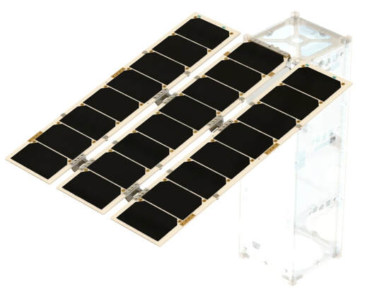
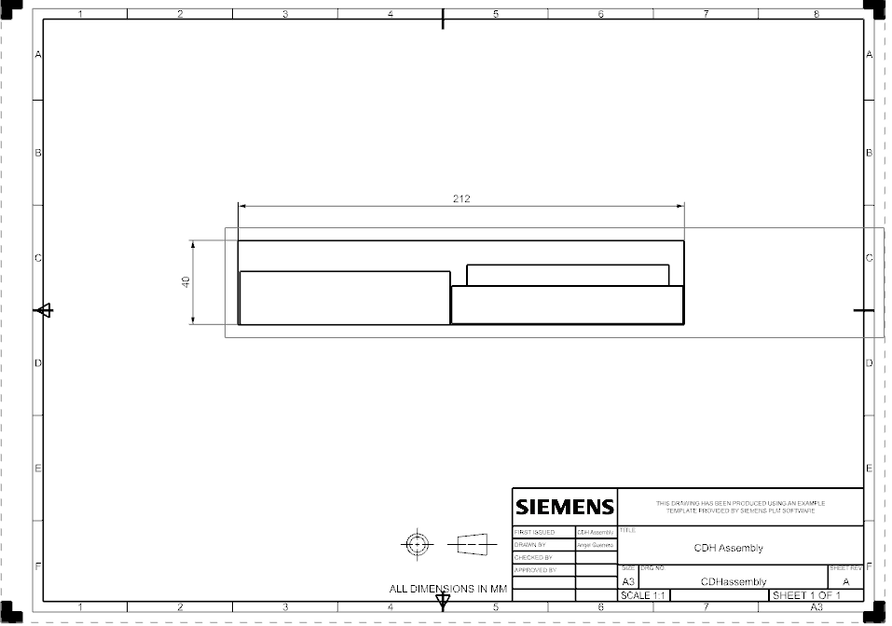
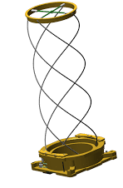
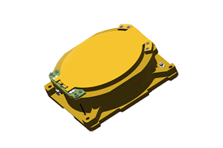
CDH: Command and Data Handling
External Communications
Internal Communications
Storage
Transceiver
Onboard Computer
Notes:
CDH (or Command and Data Handling) is responsible for the flow of data in the system, and also its interaction and timing throughout the Aerobot system.
CDH takes little space physically, fitting into a 40 by 212 mm box.
External comms are deployable, and mounted outside the chassis (for space)
On the nest slide, we will see that despite the low physical presence, …

Slide 15
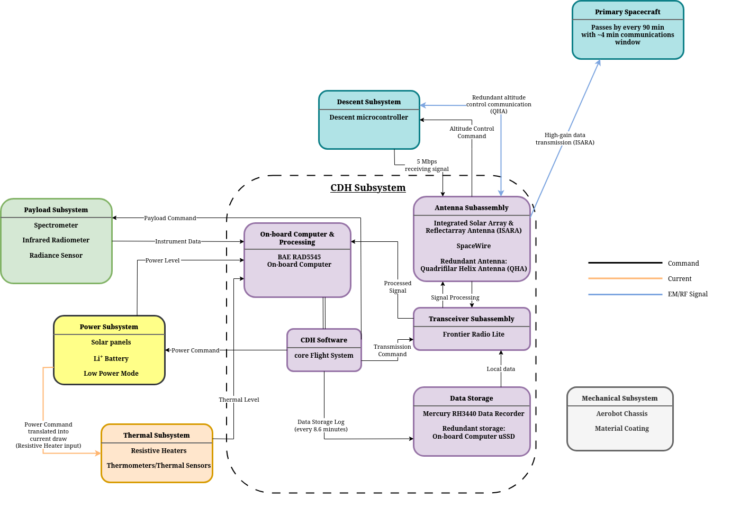
SAFC: Software Architecture Flowchart
Internal Communications
External Communications
Notes:
The SAFC represents the interconnectivity of data within every subsystem housed by…
All Subsystems are connected through I/O (Sensors, command, storage logs etc.). Mechanical, however, is passive.
Interfacing will mainly integrated using SpaceWire, but also utilizes current, and RF comms based on what best carries the type of data being handled.
RF is vital for external communication, so with DSS, orbiter
Antennas were chosen with the primary consideration of promoting the integrity of science data: to mission control and ultimately earth.

Slide 16
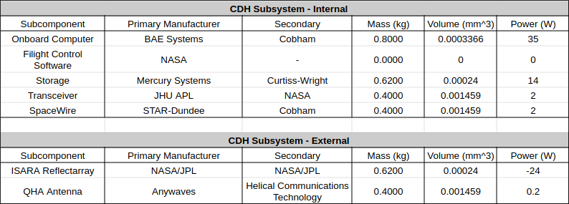







CDH: Manufacturers
Notes:
These manufacturers were chosen for their substantial experience in producing rad hard
They are the best bet for preserving science without corruption and noise.
CDH will rely heavily on power to modulate data flow, covered in the next slide.

Slide 17
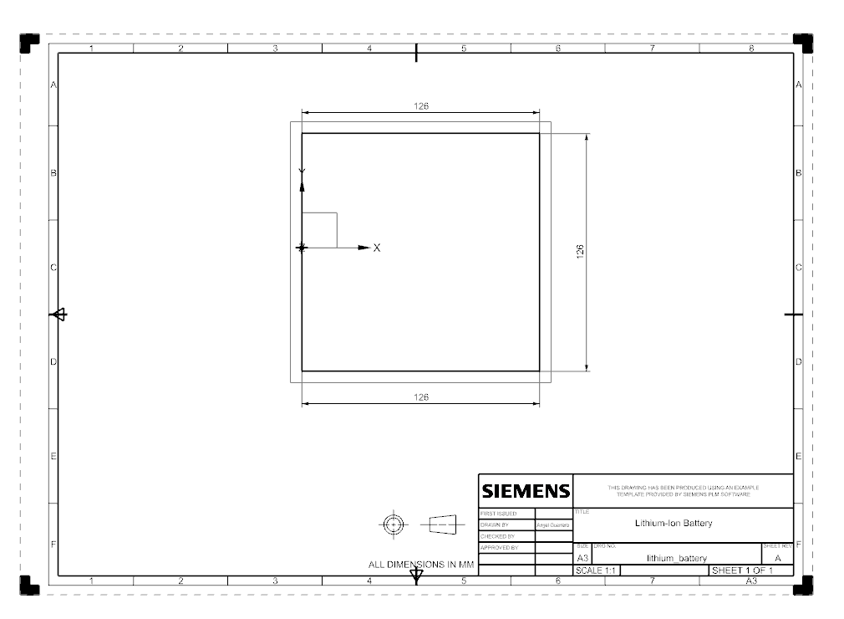
Power Subsystem
3 Main components:
Battery (lithium ion)
Most efficient, low self-discharge, high specific energy (Wh/kg)
Main power source at lower altitudes
4kg
800Whr
TRL: 6
Notes:
Matthew

Slide 18
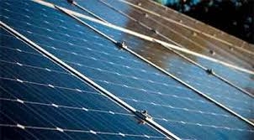
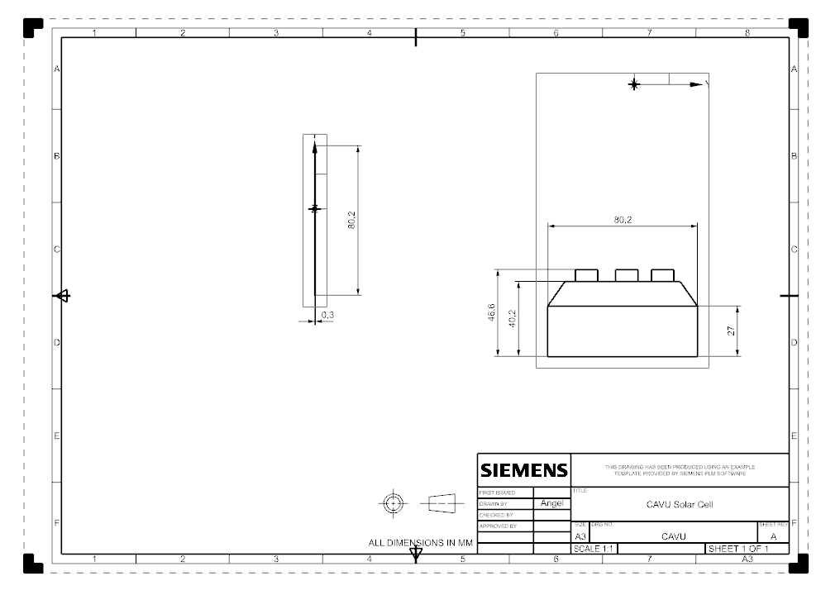
Solar panels (gallium arsenide)
Wide temperature operating range, high efficiency
632W generated (assuming optimal sunlight, including inefficiencies)
Main source in higher altitudes, charges battery
TRL: 6

Slide 19
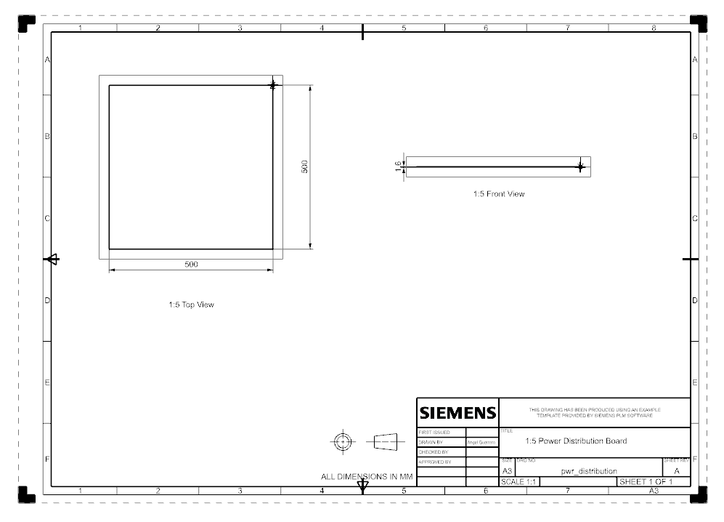
Power distribution board
Interfaces w/all other subsystems
Converts & provides necessary power to all subsystems
In middle to reduce wire length, power loss
Made in house (unique power requirements)
1.5kg
TRL (PCB technology): 6

Slide 20
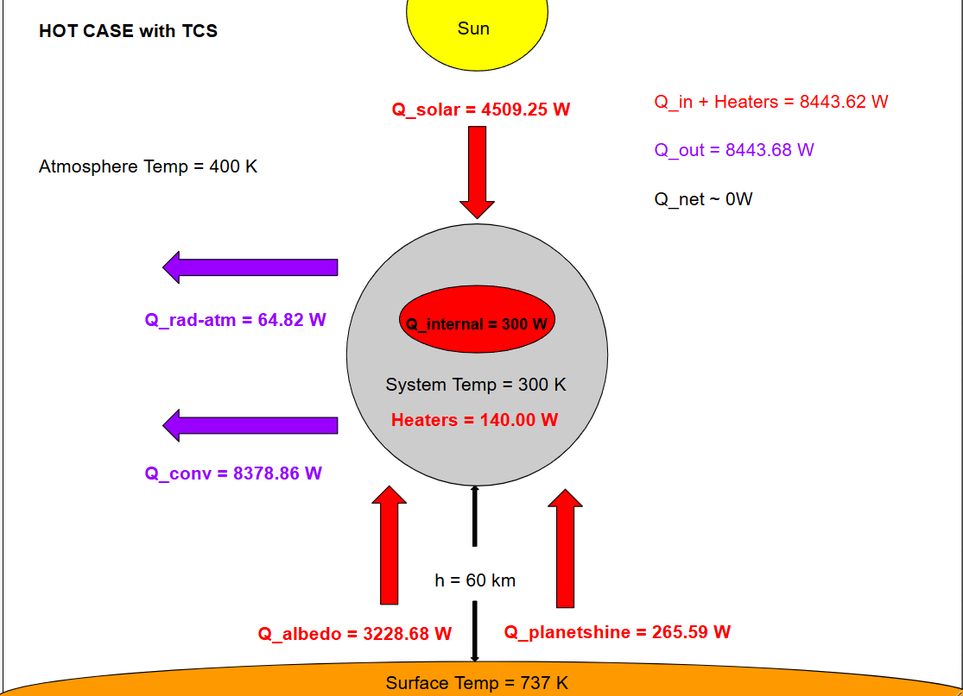
Heat Flow Map: Hot Case with TCS
Thermal Control System (TCS):
Flat Black Paint Coating
Absorptivity = 0.99
Copper Gold MLI
Emissivity = 0.01
TRL: 5
Required Heating: 140 W
*Assume closed system

Slide 21
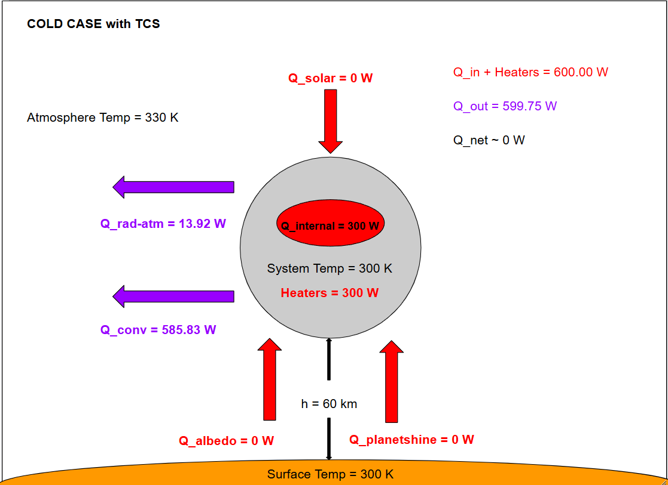
Heat Flow Map: Cold Case with TCS
Thermal Control System (TCS):
Flat Black Paint Coating
Absorptivity = 0.99
Copper Gold MLI
Emissivity = 0.01
TRL: 5
Required Heating: 300 W
*Assume no sun

Slide 22
Risk Mitigation
Function
Failure Mode
Prevention
Mechanical
Vibration impact
- Spherical chassis
- Connection/interface
CDH
Cyberattacks
Core Flight System selection
Power
Battery Overheating
- Voltage protection
- Low power mode
Programmatics
Mass Limit
Continuous mass calculations
Notes:
Grace

Slide 23
Safety & Hazard Mitigation (RIDM + CRM):
Planetary Protection: EOL deorbiting plan aligns with NASA debris guidelines.
Personnel Safety (Machining/ / electrical/Chemical): PPE, lockout-tagout, fume hoods, battery safety.
Descope: Support scope changes by assessing risks, adjusting plans, and maintaining mission alignment.
Decommissioning: Ensuring safe shutdown of system while meeting NASA’s risks, safety, data policies.
Ergonomics & Mental Health: Adjustable workplace, task rotation, wellness check-ins.
Notes:
Brisa

Slide 24
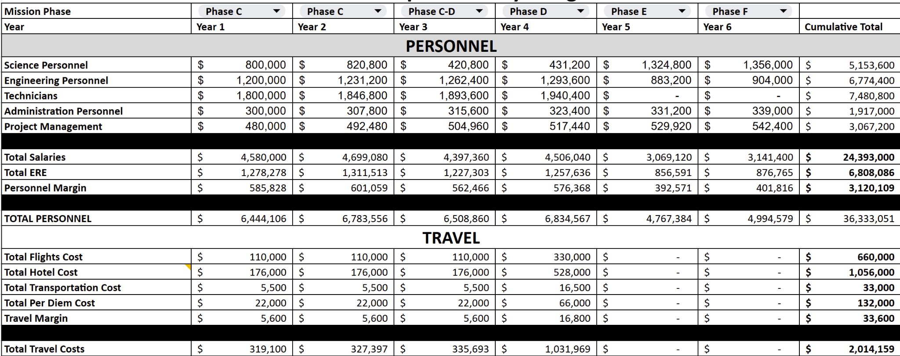
Personnel and Travel Costs
Your overall mission cost

Slide 25
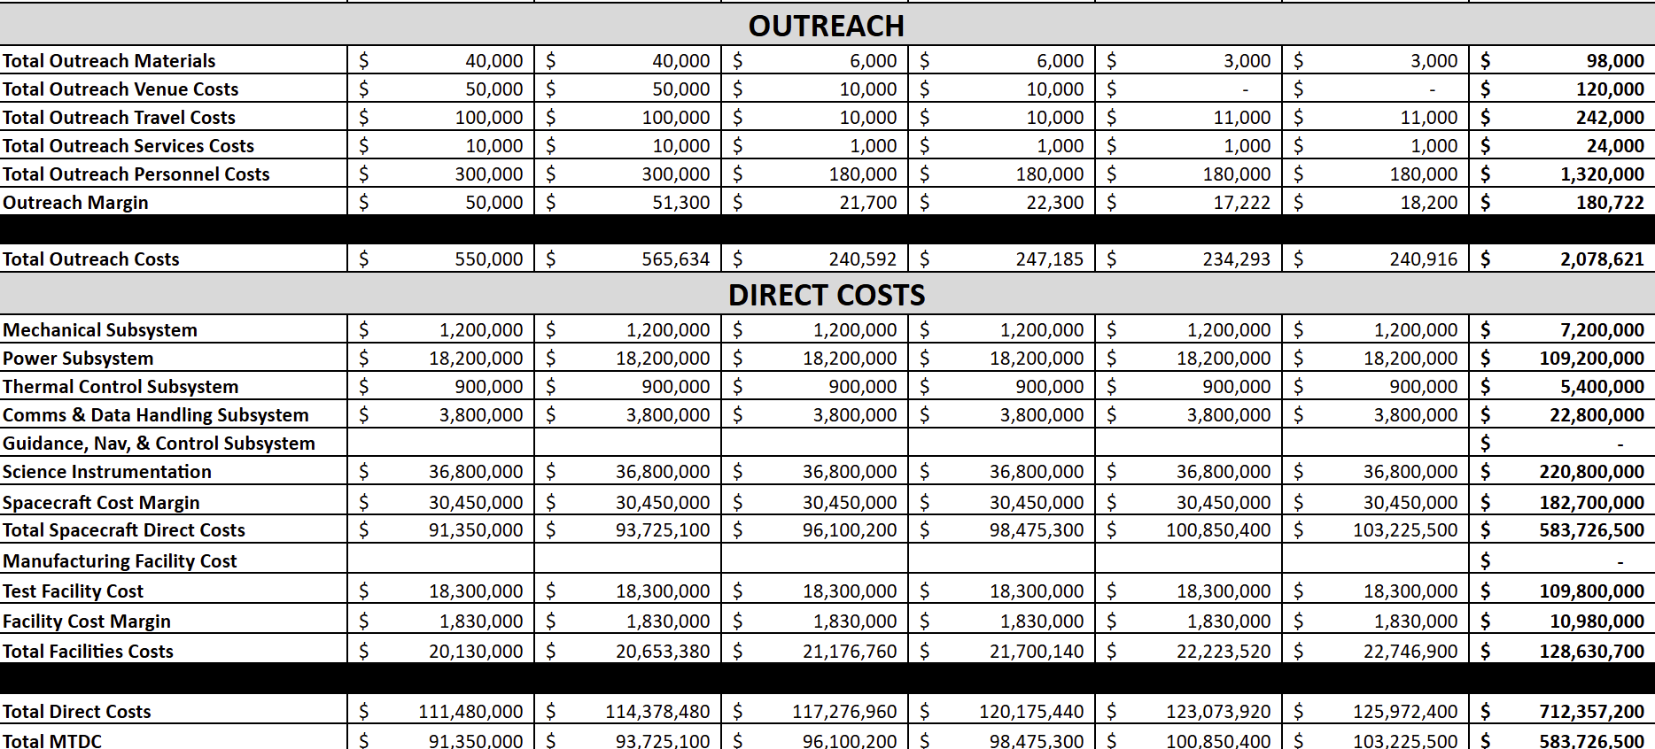
Outreach and Direct Costs

Slide 26
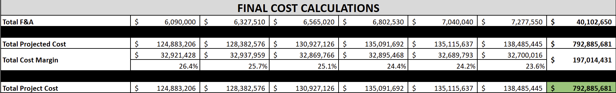
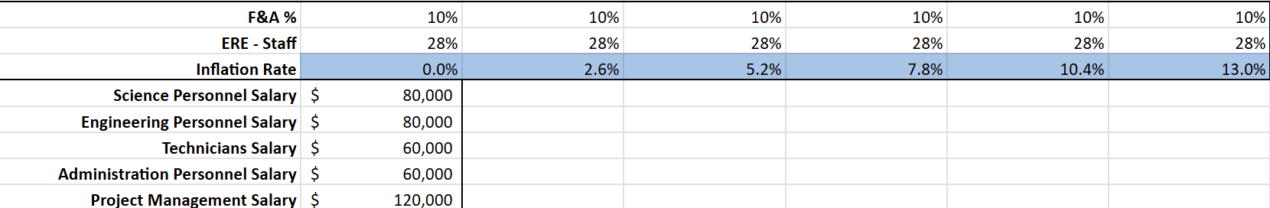
Final Costs

Slide 27
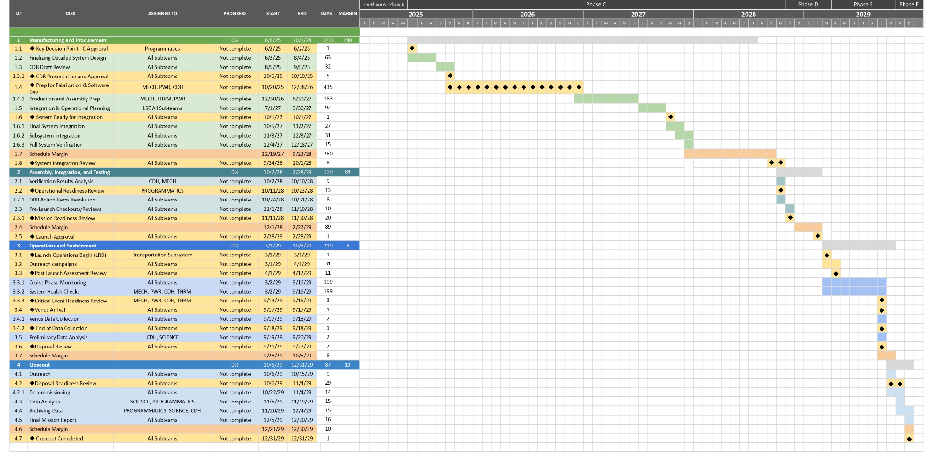
Overall Schedule
CDR -> SIR -> ORR -> MRR -> PLAR -> CERR -> DR -> DRR
Notes:
Luis

Slide 28
Conclusion
PDR Key Takeaways:
Thoroughly evaluated potential risks stemming from the Mission Concept to ensure mission success.
Identified technical, environmental, and operational risks associated with deploying the Aerobot into Venus’ extreme atmospheric conditions.
Mitigated risks through design refinements, updated risk management strategies, and contingency planning.
Established protocols for continuous monitoring and adaptation of risk mitigation efforts throughout the mission lifecycle.
Mission Overview:
Aerobot system deployed in Venus' atmosphere for scientific investigations.
Essential subsystems: Science/Payload, Power, Thermal, Mechanical, and CD&H.
Delivered by a descent system ensuring controlled entry and steady operation in Venusian cloud layer/
Designed to support a science payload, maintain stability and data transmission throughout the mission.
Notes:
Shehan/team leads

Slide 29
Next Steps
Looking Ahead:
Focus on Critical Design Review (CDR) preparation.
Subsystem design reviews and interface documentation finalization.
New spectrometer integration under consideration to enhance performance.
Expand outreach strategy: mission social media, STEM workshops, and career fair presentations.
CDR Goals:
Validate that design is ready for fabrication and implementation.
Ensure performance validation and risk mitigation strategies are in place.
Notes:
Shehan/team leads

Slide 30
BACKUP SLIDES

Slide 31
Resources
Obkio. "How to Measure Latency." Obkio Blog. Accessed April 25, 2025. https://obkio.com/blog/how-to-measure-latency/.

Slide 32
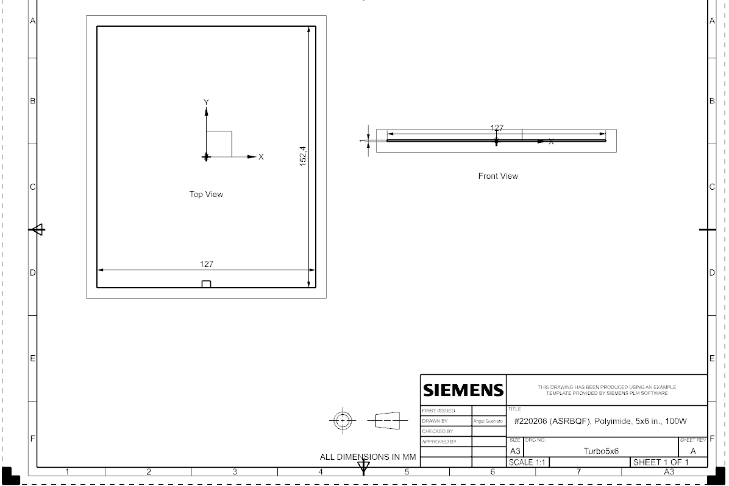

Sub-Assembly: TurboFlex Heat Strips (100 W)
Heating: 100 W
Quantity: 3
TRL: 4
Mass: 0.02954 kg
Dimensions: 127 x 152.4 x 1 mm
Manufacturer: TurboFlex Heaters

Slide 33
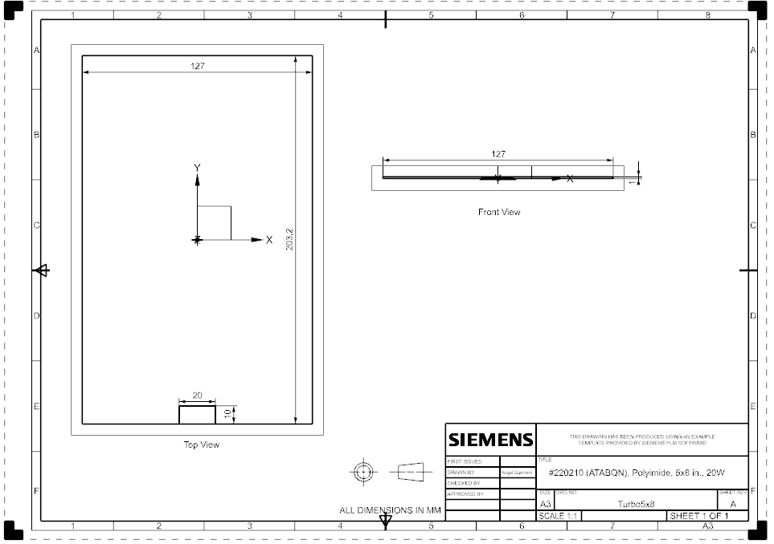
Sub-Assembly: TurboFlex Heat Strips (20 W)
Heating: 20 W
Quantity: 2
TRL: 4
Mass: 0.0588 kg
Dimensions: 127 x 203.2 x 1 mm
Manufacturer: TurboFlex Heaters

Slide 34
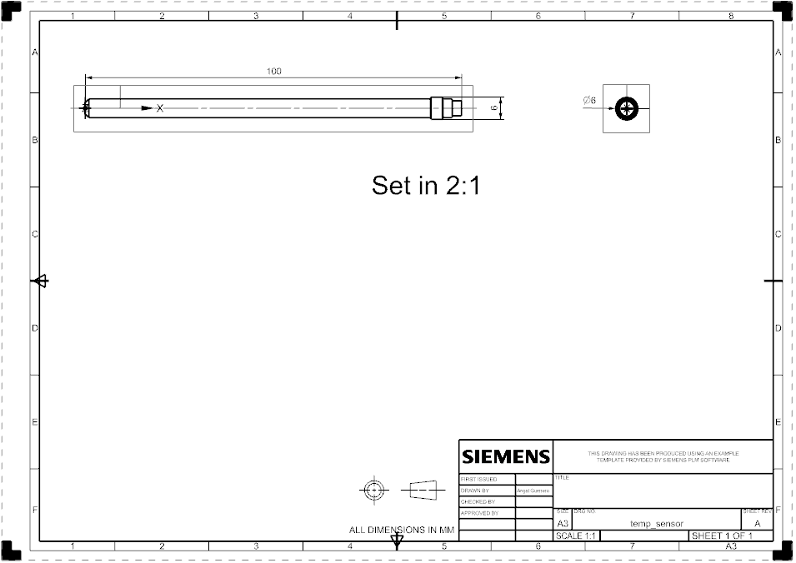

Sub-Assembly: ST-100 Thermistor
Temperature Sensor
Temperature Range: 223 K - 343 K
TRL: 4
Mass: 0.06 kg
Dimensions: 100 x 6Ø mm
Manufacturer: Apogee Instruments
*Activates/Deactivates heaters upon ±15K temperature change

Slide 35
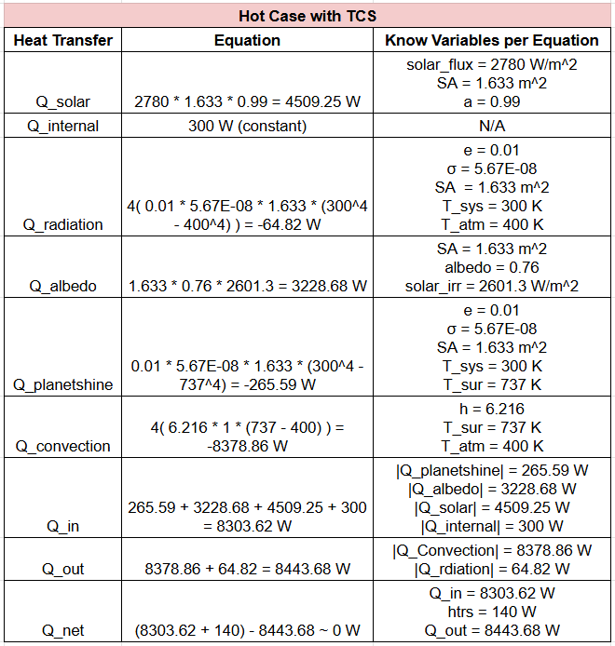
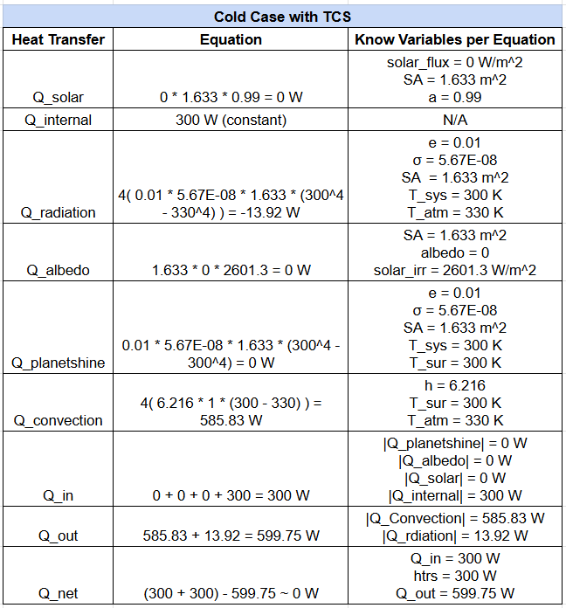
Thermal Calculations

Slide 36
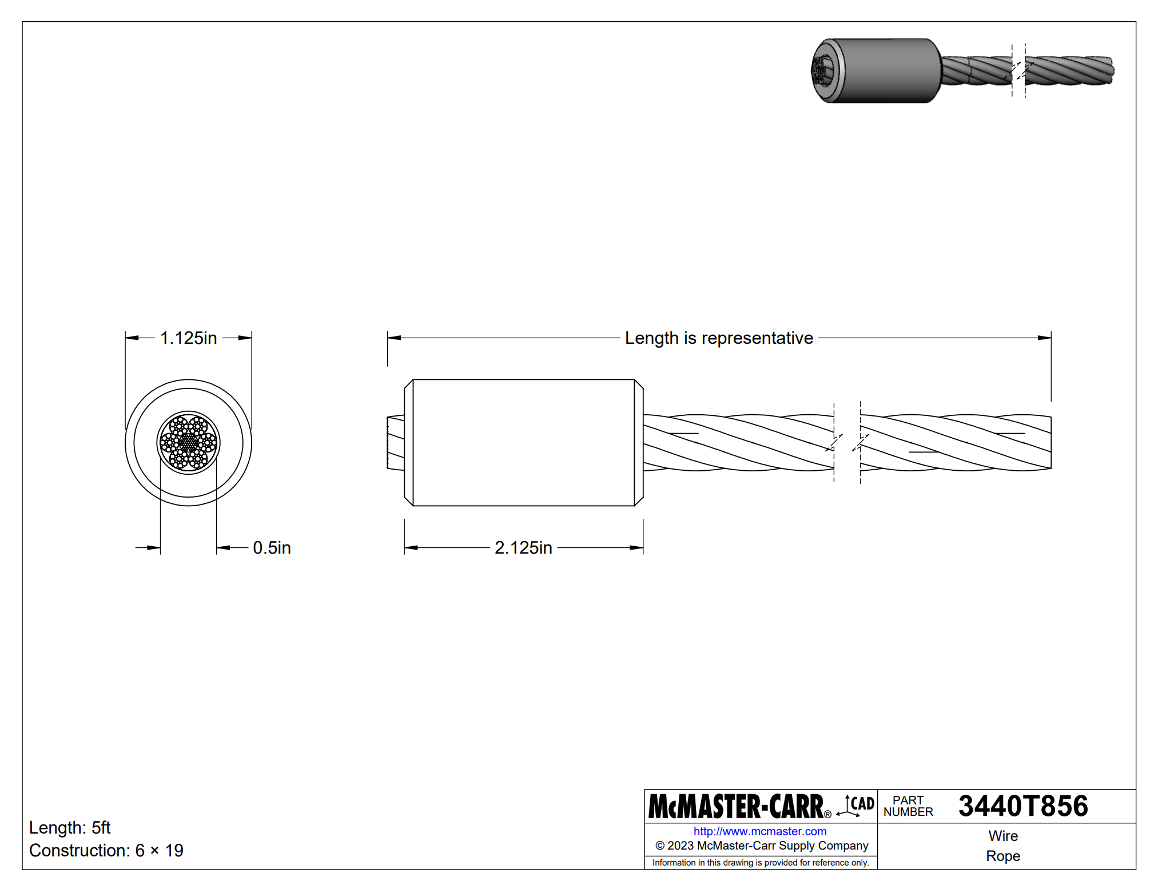
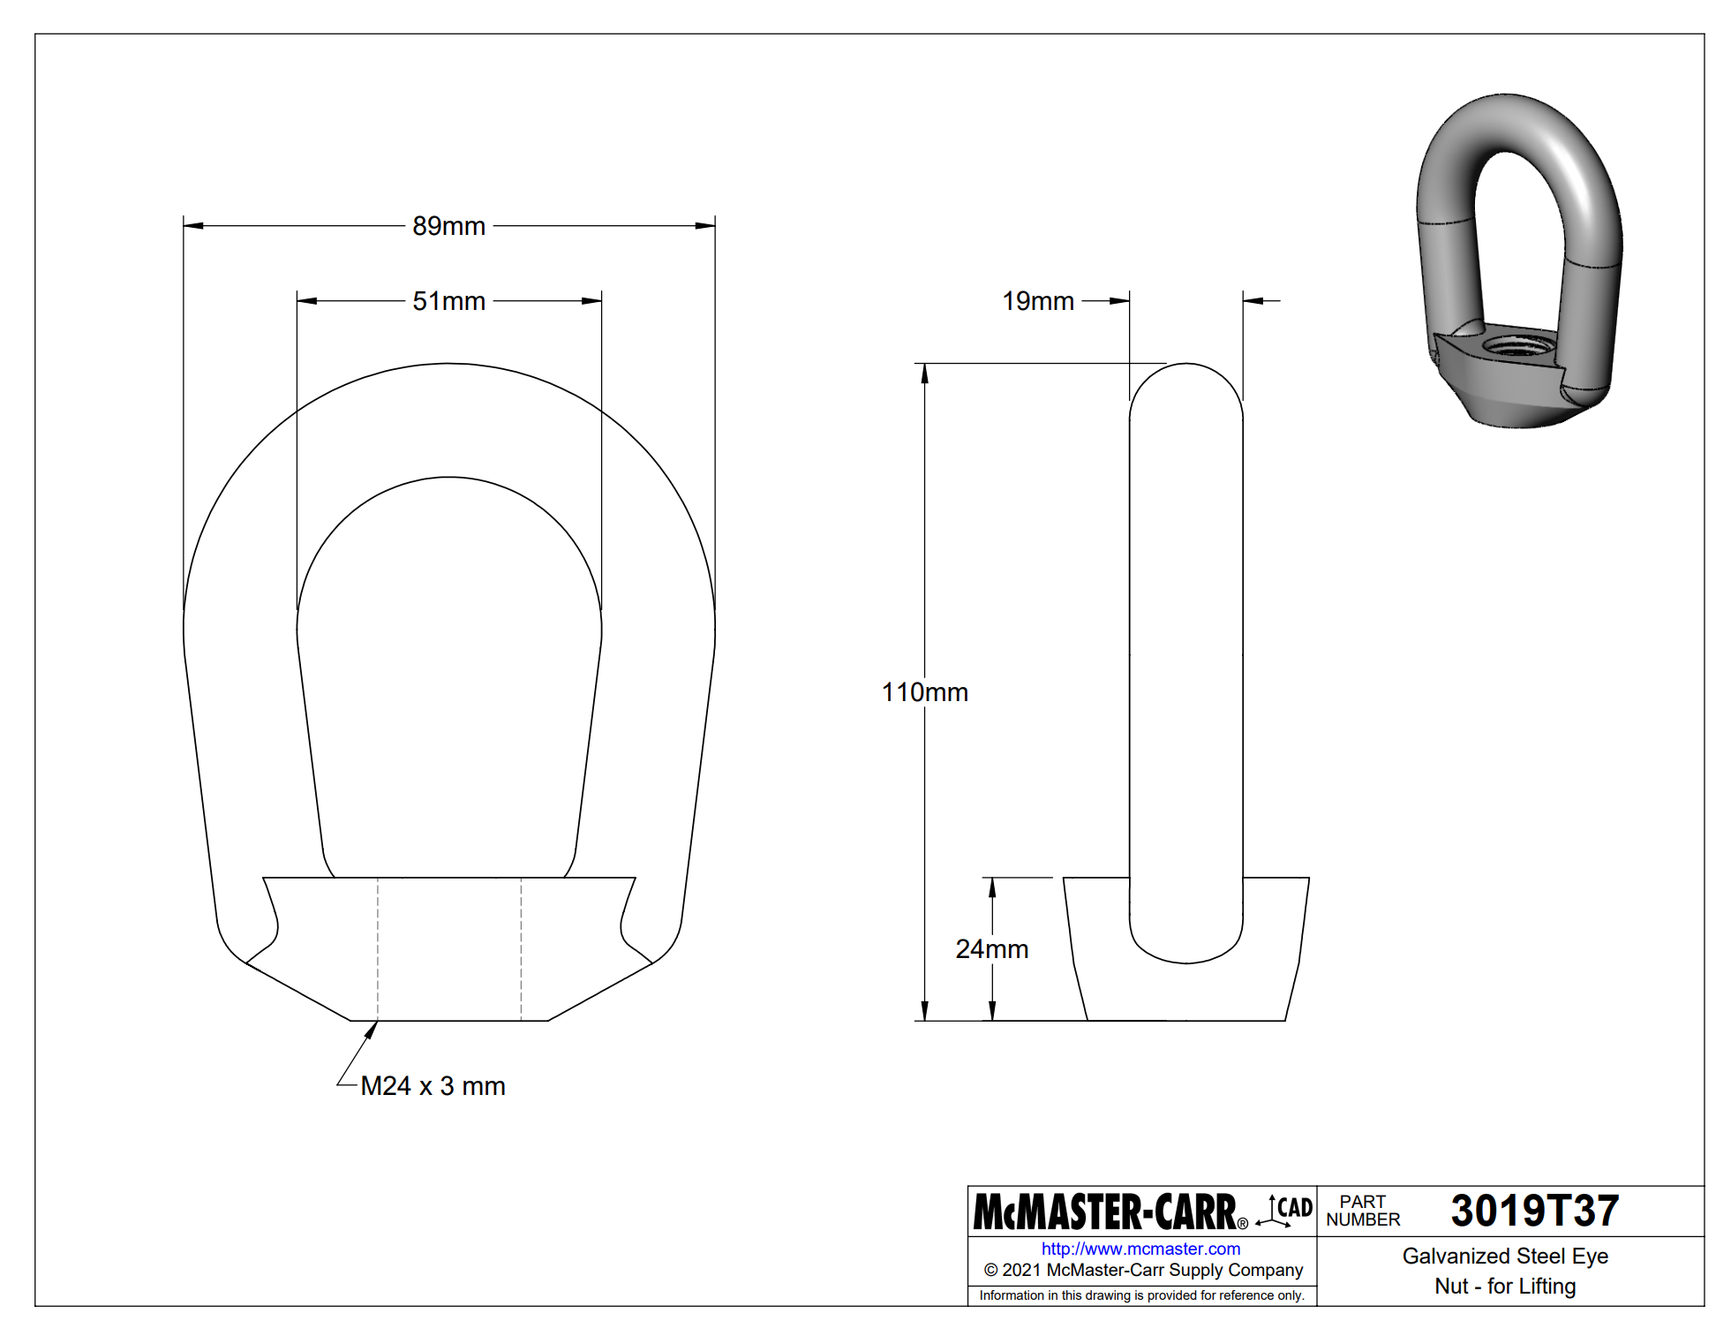
Mechanical Assembly Components
McMaster - Carr, Clarendon
Expected 30 day lead time.
Tensile strengths of over 200 MPa in target environment
Thermally inert.
TRL 3
Mass: 1.92 kg (total cable), 0.6 kg (total eye)
Notes:
Biggest item for securing and assembling the components was ensuring that material and construction of choice would sustain the mass of the aerobot and stresses of launch, travel, EDI, and operation in the Venusian atmosphere.
The literature for our corrosion resistance coating selections Confident in alloy usage while in space

Slide 37
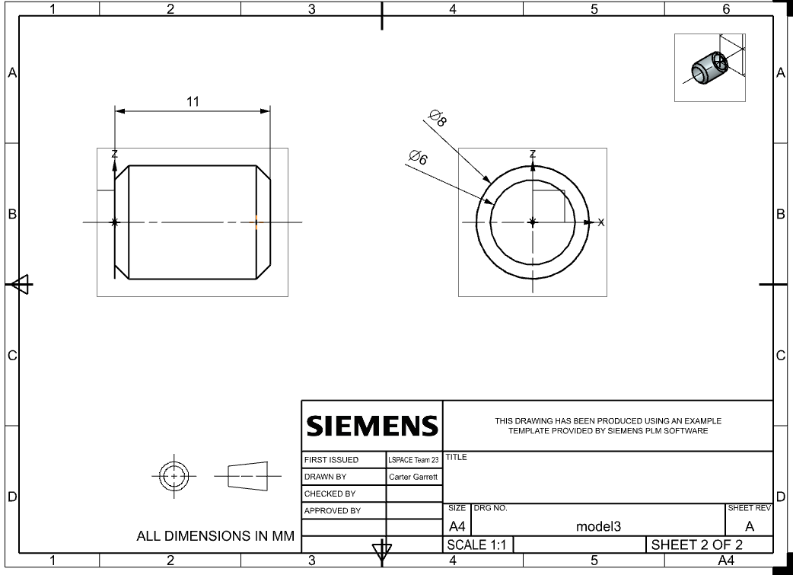
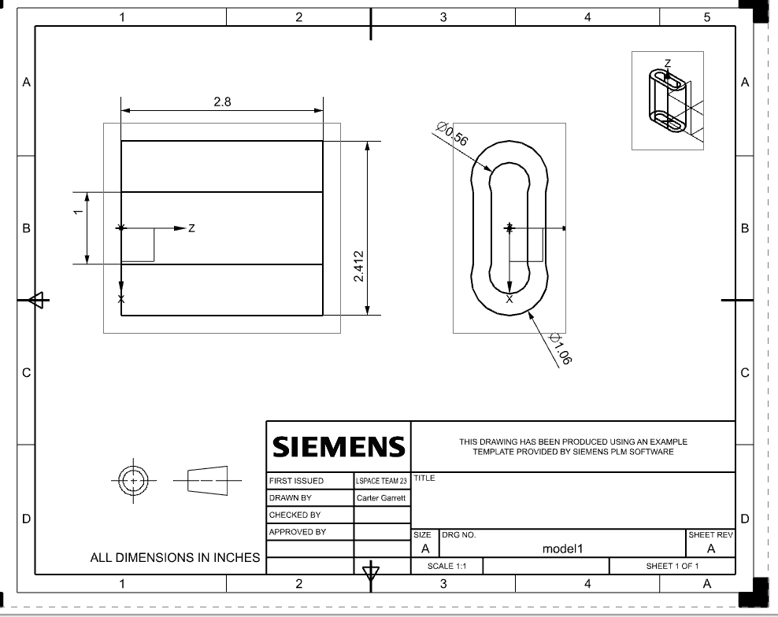
Mechanical Assembly Components
Couplings and sleeves
Steel and Inconel Alloys
Strength ratings well beyond requirement
Low thermal expansion properties
Chemically inert
TRL 3 (sleeves, couplings).
Mass: 0.3 kg (Sleeves),
Notes:
Confident in alloy usage while in

Slide 38
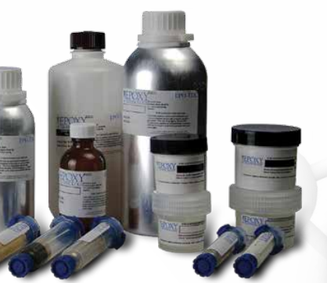
Mechanical Assembly Components
EpoTek
Maximum 30 day lead time, 5 days expected
Transmittant for optics and conductive up to 1500 Cº
Hermetic Sealant
NASA ASTM Outgassing Standards
TRL 4 (adhesive)
Mass: 0.2 kg (total adhesive)

Slide 39
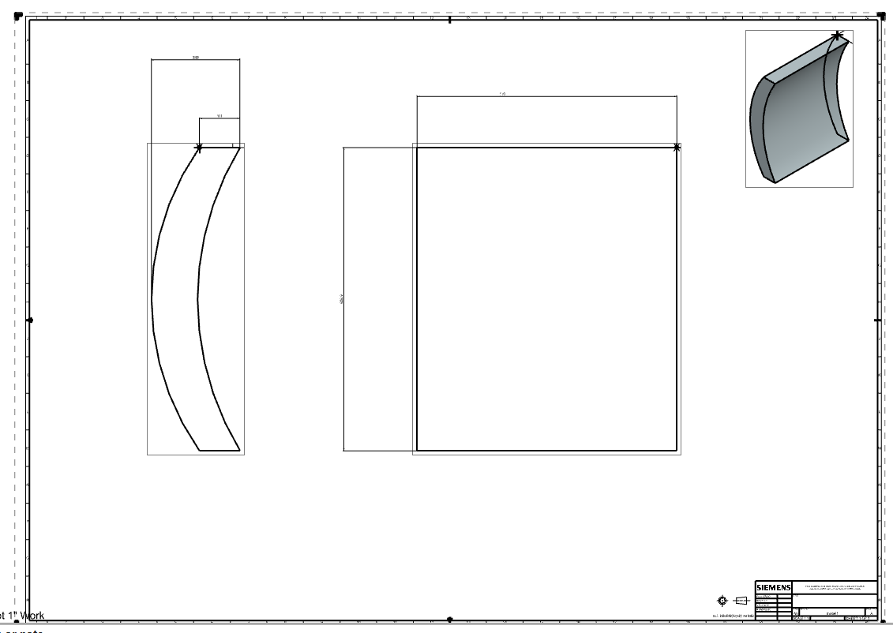
Mechanical Assembly Components
Meller Optics
Maximum 7 week lead time, 3 weeks expected
2040 Cº melting,
Incredible mechanical properties, 9 Moh’s hardness
TRL 4 (sapphire),
Mass: 1.085 kg
Vargas, William E, Junxin Wang, and Gunnar A Niklasson. 2021. “Effective Backscattering and Absorption Coefficients of Light Diffusing Materials Retrieved from Reflectance and Transmittance Spectra of Diffuse Radiation.” Journal of Modern Optics 68 (12): 605–23. https://doi.org/10.1080/09500340.2021.1936244.
‌
Notes:
Confident in alloy usage while in

Slide 40
Power Calculations
Maximum descent/ascent time = (upper altitude - lower altitude)/(descent/ascent velocity) = (70km - 50km)/(5m/s) = 4000s = ~1hr 7min
Solar panel total area = 0.98m * 0.82m = 0.8036m^2
Total solar panel power generation = solar panel area * Venus solar constant * solar panel efficiency = 0.8036m^2 * 2622W/m^2 * 30% = 632.11 watts
Battery capacity = mass of batteries used * specific energy of battery = 4kg * 200W/kg = 800W
Data sending phase: 61.3W + 340W + 44W + 0.5 (DSS) = 445.8W
Battery charging phase: 49W (CDH) + 340W (thermal) + 0.5 (DSS) = 389.5W
Descent and ascend (will take about an half an hour): 49W (CDH) + 340W (thermal) + 10.5W (DSS) = 399.5W Science cycle (slightly less than an hour): 44W (Science) + 49W (CDH) + 340W ( thermal) + 0.5 (DSS) = 433.5W
Left over power to charge battery = 632.11W - 389.5W = 242.61W
Time to charge battery = battery capacity / power charging = 800 / 133.04 = ~3.3 hours

Slide 41
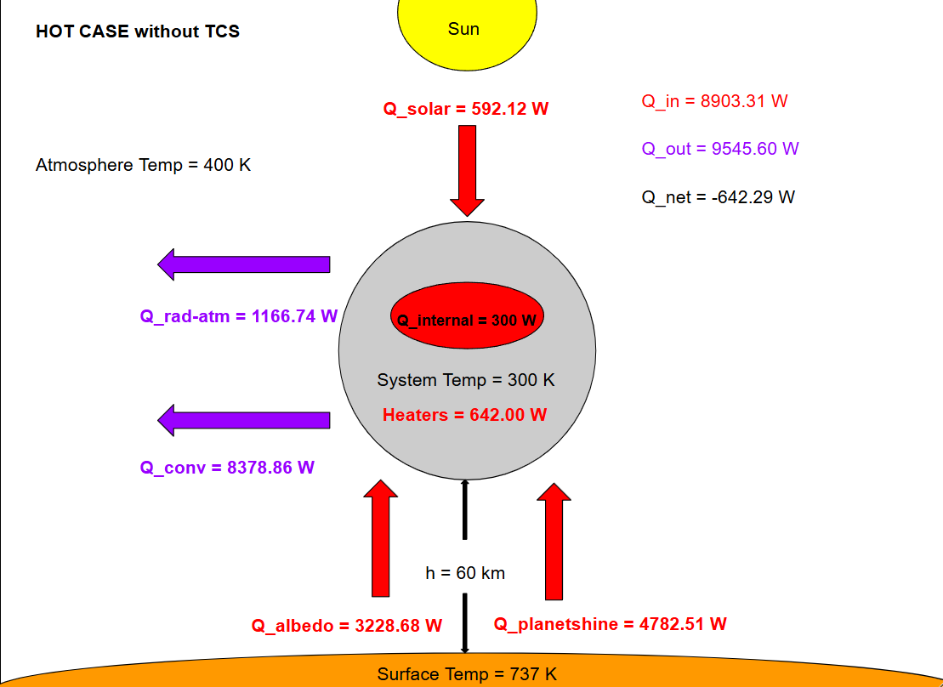
Heat Flow Map without TCS

Slide 42
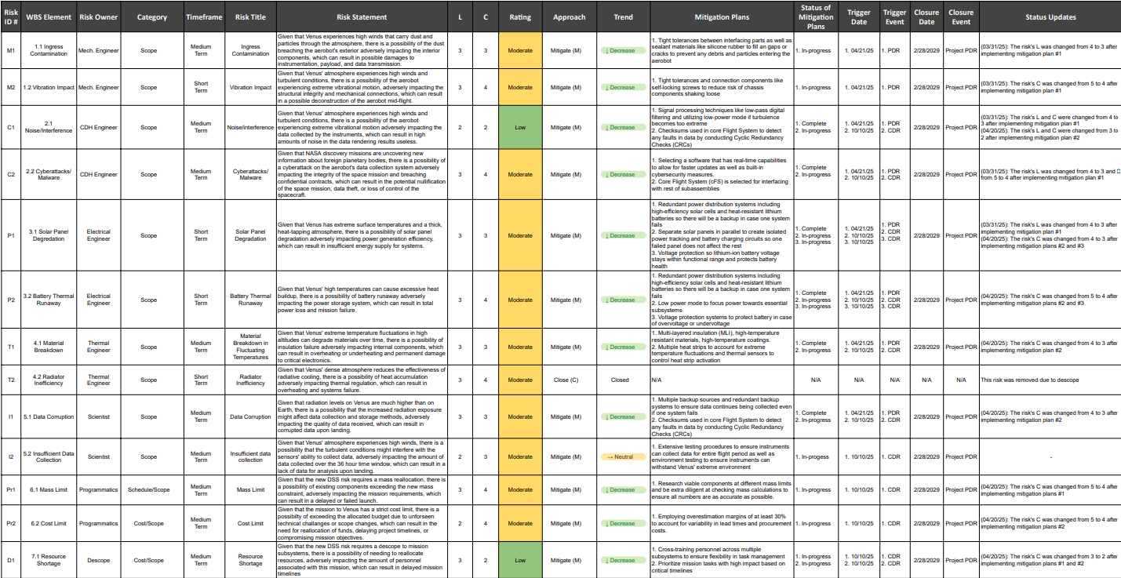
Extra Risks Resources

Slide 43
*Additional Tips*
Keep in mind: the general goal is for your reviewers to come out of the presentation with a top level understanding of your mission. This can best be done by pulling from your PDR document and summarizing key elements.
Have minimal text when applicable. Verbally expand on what is written down rather than writing it all out.
Pick a format for your slides and stay consistent throughout.
Make sure any designs or images used are related to your mission (don’t include an image of an astronaut if it is not a crewed mission, or the Moon if it is a Mars mission).
Any graphics included are clear, relevant, and cited if not created by your team.
Do not read from the slides word for word.
Limit filler words (um, uh, er, you know, so yeah, etc.) when presenting.

